Slide 1

13th International Conference on Computer and Knowledge Engineering
(ICCKE2023)

Slide 2
Theophilus Ebuka Odoh
DFIG-WECS Renewable Integration to the Grid and Stability Improvement through Optimal Damping Controller Design

Slide 3
OUTLINE OF THE PRESENTATION
Introduction
Problem statement
Aim and Objectives
Literature review
Research gap
Methodology
Results
Contribution to knowledge
Conclusion
Recommendations
References

Slide 4
INTRODUCTION
DFIG-WECS is integrated to the power grid system to improve power generation capacity and to maintain a sustainable environment.
Power system stability is a major concern for successful operation of an integrated power grid system specifically rotor angle stability.
Damping Controllers like Power system stabilizer (PSS) is used to damp electromechanical oscillations and maintain rotor angle stability.

Slide 5
Problem Statement
There is need to maintain a sustainable environment and to improve power generation capacity to meet daily demand.
Power system stability particularly Rotor angle stability is a major concern while improving power generation capacity.
Damping controllers such as the PSS damping controller is required for Rotor angle stability.
Optimization is required in the PSS damping controller design.

Slide 6
Aim and Objectives
The aim of this research was to study the rotor angle stability of a grid-connected renewable energy source
This research aim was achieved through the following objectives:
Design of the Kundur’s IEEE two area power test system in Matlab/Simulink.
Integration of a doubly fed induction generator (DFIG) wind energy conversion system into the Kundur’s IEEE power test system
PSS damping controller using the artificial eco-system (AEO) optimization method for the integrated system.

Slide 7
Literature review
Title and Reference | Methodology | Result | Research gap
Artificial Intelligence Based Power System Stabilizers for Frequency Stability Enhancement in Multi-machine Power Systems [1] | PSS, IPFC and Neuro-fuzzy controller were applied in the test systems for power oscillation damping | The Neuro-fuzzy controller performed better than PSS and IPFC when compared | Renewable energy source was not considered
Coordinated Design of PSS and IPFC Using FFA to Control Low Frequency Oscillations [2] | PSS and IPFC controllers were combined for low frequency oscillation damping | The combined controller performed better than PSS or IPFC controller only | Renewable energy source was not considered
Farmland fertility optimization for designing of interconnected multi-machine power system stabilizer [3] | PSS damping controllers were designed in a multi-machine power system using FFA | FFA PSS damping controller performed better than PSO and GA PSS damping controllers | Renewable energy source was not considered
Mitigation of Oscillations in SMIB using a Novel Farmland Fertility Optimization based PIDPSS [4] | PID and PSS controllers were combined for oscillation damping in a SMIB system | The combined controller performed better than PSS or PID controller only | Renewable energy source was not considered
Implementing Optimization Techniques in PSS Design for Multi-Machine Smart Power Systems: A Comparative Study [5] | Nature inspired algorithms and Physics inspired metaheuristic were compared in optimal design of PSS damping controllers in WSCC system | Physics inspired metaheuristic performed better than Nature inspired algorithms in PSS damping controller design. | Renewable energy source was not considered

Slide 8
Research Gap
The research filled the above gaps by:
Designing an AEO based PSS damping controller for the DFIG-WECS integrated to the Kundur’s IEEE power test system to improve the generation capacity of the power grid system and maintain rotor angle stability.

Slide 9
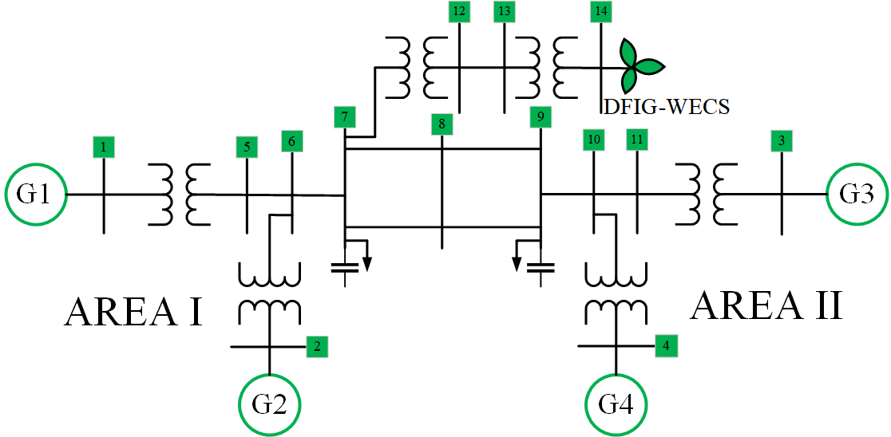
Methodology
The Kundur’s 2-area power test system augmented with DFIG-WECS

Slide 10
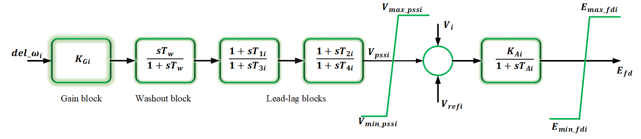
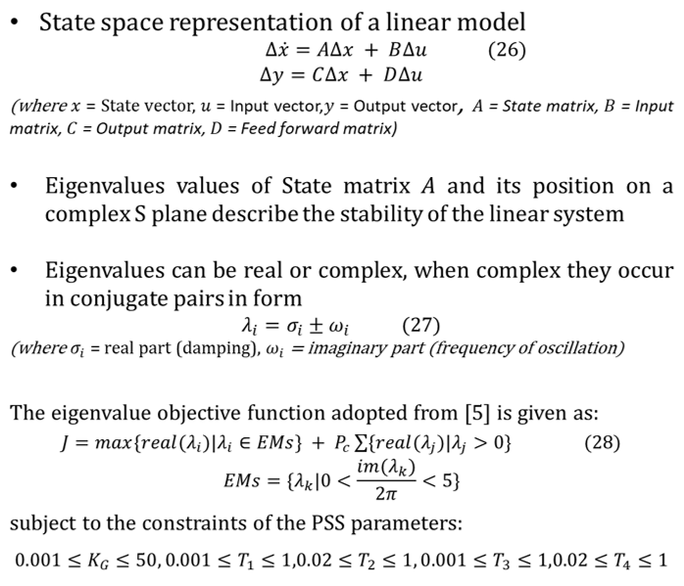
PSS Damping controller model design
PSS damping controller model
Complex S-plane

Slide 11
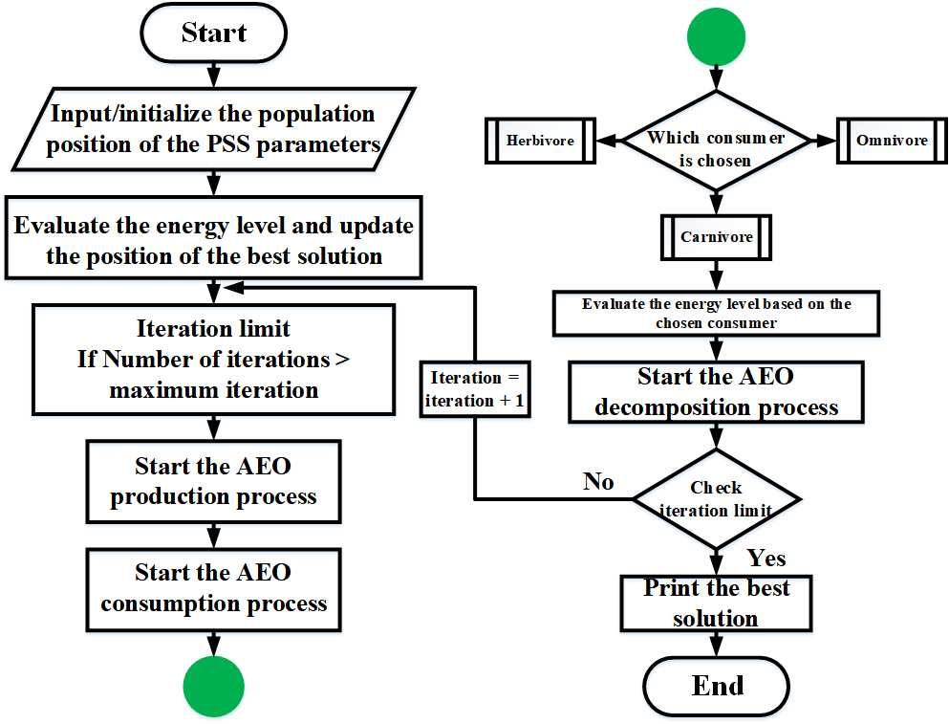
AEO
AEO mimics Production, consumption and decomposition behaviors of living organisms
The production operation enhances the exploitation and exploration balance, the consumption operation improves the algorithm’s exploration ability, and the decomposition process improves exploitation in the algorithm.
Flow chart of the AEO Process

Slide 12
Results
Time domain simulation of the uncontrolled synchronous generator rotor speed deviation
Time domain simulation of the uncontrolled synchronous generator rotor angle deviation

Slide 13
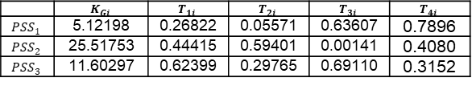
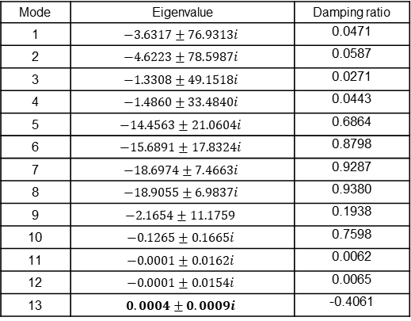
mode of oscillation, the dominant eigenvalues, and the damping ratio of the uncontrolled power system
Optimized PSS damping controller parameters
 | $$K_{Gi}$$ | $$T_{1i}$$ | $$T_{2i}$$ | $$T_{3i}$$ | $$T_{4i}$$
$${PSS}_{1}$$ | 5.12198 | 0.26822 | 0.05571 | 0.63607 | 0.7896
$${PSS}_{2}$$ | 25.51753 | 0.44415 | 0.59401 | 0.00141 | 0.4080
$${PSS}_{3}$$ | 11.60297 | 0.62399 | 0.29765 | 0.69110 | 0.3152
Mode | Eigenvalue | Damping ratio
1 | $$−3.6317±76.9313i$$ | 0.0471
2 | $$−4.6223±78.5987i$$ | 0.0587
3 | $$−1.3308±49.1518i$$ | 0.0271
4 | $$−1.4860±33.4840i$$ | 0.0443
5 | $$−14.4563±21.0604i$$ | 0.6864
6 | $$−15.6891±17.8324i$$ | 0.8798
7 | $$−18.6974±7.4663i$$ | 0.9287
8 | $$−18.9055±6.9837i$$ | 0.9380
9 | $$−2.1654±11.1759$$ | 0.1938
10 | $$−0.1265±0.1665i$$ | 0.7598
11 | $$−0.0001±0.0162i$$ | 0.0062
12 | $$−0.0001±0.0154i$$ | 0.0065
13 | $$0.0004±0.0009i$$ | -0.4061
Time domain simulation of the controlled synchronous generator rotor speed deviation

Slide 14
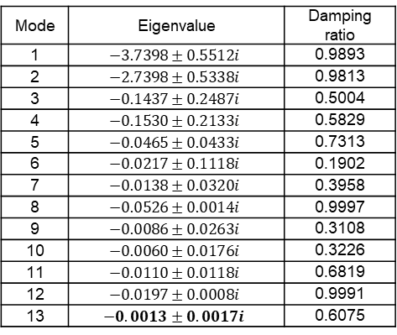
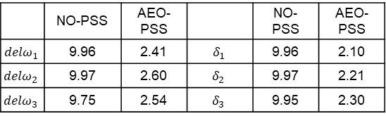
Time domain simulation of the controlled synchronous generator rotor angle
Mode | Eigenvalue | Damping ratio
1 | $$−3.7398±0.5512i$$ | 0.9893
2 | $$−2.7398±0.5338i$$ | 0.9813
3 | $$−0.1437±0.2487i$$ | 0.5004
4 | $$−0.1530±0.2133i$$ | 0.5829
5 | $$−0.0465±0.0433i$$ | 0.7313
6 | $$−0.0217±0.1118i$$ | 0.1902
7 | $$−0.0138±0.0320i$$ | 0.3958
8 | $$−0.0526±0.0014i$$ | 0.9997
9 | $$−0.0086±0.0263i$$ | 0.3108
10 | $$−0.0060±0.0176i$$ | 0.3226
11 | $$−0.0110±0.0118i$$ | 0.6819
12 | $$−0.0197±0.0008i$$ | 0.9991
13 | $$−0.0013±0.0017i$$ | 0.6075
Numerical comparison of the rotor speed and angle deviation between NO-PSS and AEO-PSS controller in terms of settling time in seconds
Mode of oscillation, the dominant eigenvalues, and the damping ratio of the uncontrolled power system
 | NO-PSS | AEO-PSS |  | NO-PSS | AEO-PSS
$${delω}_{1}$$ | 9.96 | 2.41 | $$δ_{1}$$ | 9.96 | 2.10
$${delω}_{2}$$ | 9.97 | 2.60 | $$δ_{2}$$ | 9.97 | 2.21
$${delω}_{3}$$ | 9.75 | 2.54 | $$δ_{3}$$ | 9.95 | 2.30

Slide 15
Contribution to knowledge
This present study considered PSS damping controller design using the Artificial ecosystem optimization (AEO) algorithm in a DFIG-WECS integrated into the Kundur’s IEEE 2-area power test system.

Slide 16
Conclusion
This study has presented PSS damping controller design in a DFIG-WECS integrated to the Kundur’s 2-area power test system to control and damp electromechanical oscillations in the power grid system. The PSS controller parameters were obtained using AEO algorithm for optimal performance. In this study was the following scenario were compared; No-PSS controller installed, PSS controller installed but not optimized (conventional PSS damping controller) and PSS damping controller installed and optimized using AEO algorithm

Slide 17
Recommendations
This study can be further improved Proportional Integral Derivative (PID) controllers or Flexible AC Transmission Systems (FACTs) can be coordinated together with PSS damping controller to improve its performance.
The damping controllers can incorporate neural networks, deep and reinforcement learning algorithms which are capable of handling large data values and optimization.

Slide 18
REFERENCES
[1] A. Sabo, N. I. A. Wahab, M. L. Othman, M. Z. A. B. Mohd Jaffar, H. Ackigoz, H. Nafisi, and H. Shahinzadeh, “Artificial Intelligence Based Power System Stabilizers for Frequency Stability Enhancement in Multi-machine Power Systems,” IEEE Access, vol. 9, pp. 166095–166116, 2021.
[2] A. Sabo, N. I. A. Wahab, and M. L. Othman, “Coordinated Design of PSS and IPFC Using FFA to Control Low Frequency Oscillations,” In 2021 IEEE 19th Student Conference on Research and Development (SCOReD), 2021, pp. 201–206. doi: 10.1109/SCOReD53546.2021.9652711.
[3] A. Sabo, N. I. A. Wahab, M. L. Othman, M. Z. A. M. Jaffar, and H. Beiranvand, “Farmland fertility optimization for designing of interconnected multi-machine power system stabilizer,” Appl. Model. Simul., vol. 4, pp. 183–201, 2020.
[4] A. Sabo, N. I. A. Wahab, M. L. Othman, and M. Z. A. M. Jaffar, “Mitigation of Oscillations in SMIB using a Novel Farmland Fertility Optimization based PIDPSS,” In 2020 2nd International Conference on Smart Power & Internet Energy Systems (SPIES), 2020, pp. 234–239.
[5] A. Sabo, T. E. Odoh, H. Shahinzadeh, Z. Azimi, and M. Moazzami, “Implementing Optimization Techniques in PSS Design for Multi-Machine Smart Power Systems: A Comparative Study,” Energies, vol. 16, no. 5, p. 2465, 2023.

